Slide 1
Chapter 11: File-System Interface

Slide 2

Text Book Slides – Copy Right

Slide 3
Chapter 11: File-System Interface
File Concept
Access Methods
Disk and Directory Structure
File-System Mounting
File Sharing
Protection

Slide 4
Files basic concepts
A file is a container that holds information. The format of a file is known as its data type.
Directory - listings of file names and their attributes
Within any single folder, each file name must be unique. However, files in different folders may have the same name.
As you navigate from folder to folder, your current location is referred to as the current working directory (pwd)

Slide 5
Directory Structure
A collection of nodes containing file names and inodes (information about the file)
A directory contains an entry for itself, its parent, and each of its children.
Directory
Files
F 1
F 2
F 3
F 4
F n
Both the directory structure and the files reside on disk

Slide 6
Directories
Record information about groups of files
Management of files
Single-Level directory: most simple; all files in the same directory
Two-Level directory: separate directory for each user
Tree-Structured (hierarchical) directories: most common
Operations on directories:
Search for a file
Create a file (directory entry)
Delete a file (directory entry)
List a directory
Rename a file
Traverse the file system (recursive)

Slide 7
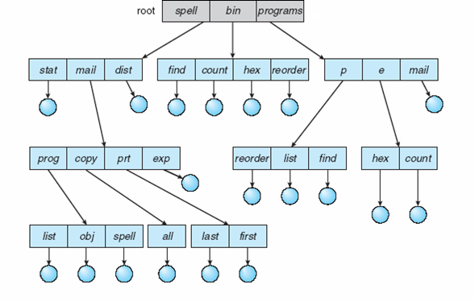
Tree-Structured Directories

Slide 8
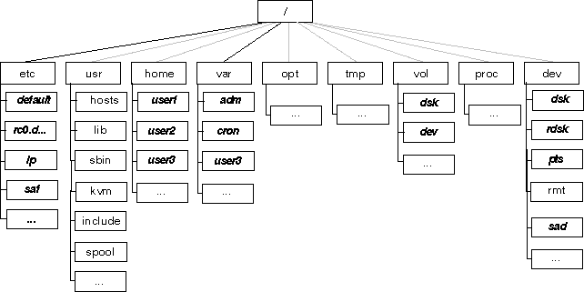
Linux File/Dir Structure
Notes:
“Permission is granted to copy, distribute and/or modify this document under the terms of the GNU Free Documentation License.”

Slide 9
File Paths
The path to an object is a way to specify where the object is located in the file system. There are two ways to specify the path:
absolute path : path that begins at the root folder. e.g. /usr/local/bin
relative path describes the location of a file or folder as it relates to the current folder. If a path does not begin with a slash, it is a relative path. E.g.
If the current directory is :
/usr/local/ and want to move to /usr/local/Adobe/Acrobat
Then the relative path is Adobe/Acrobat

Slide 10
File Attributes
Name – only information kept in human-readable form
Identifier – unique tag (number) identifies file within file system
Type – needed for systems that support different types
Location – pointer to file location on device
Size – current file size
Protection – controls who can do reading, writing, executing
Time, date, and user identification – data for protection, security, and usage monitoring
Information about files are kept in the directory structure, which is maintained on the disk
Many variations, including extended file attributes such as file checksum
Information kept in the directory structure

Slide 11
Linux File Types
In Linux file types are identify based on the magic number. Magic numbers can be seen only with hex editors
In Windows file types are identify based on the file extension
Linux supports the following file types:
Regular
Directory
Block
FIFO
Character
Link (soft link)
Socket

Slide 12
Linux File Types
The file types are defined in /usr/include/linux/stat.h file
#define S_IFREG
#define S_IFDIR
#define S_IFBLK
#define S_IFIFO
#define S_IFCHR
#define S_IFLNK
#define S_SOCK

Slide 13
Linux File Types and Properties
You can identify file types and details by
using the following commands:
ls –l and ls -F commands
file command and the file name
File Browser (GUI), usually located under system tools

Slide 14
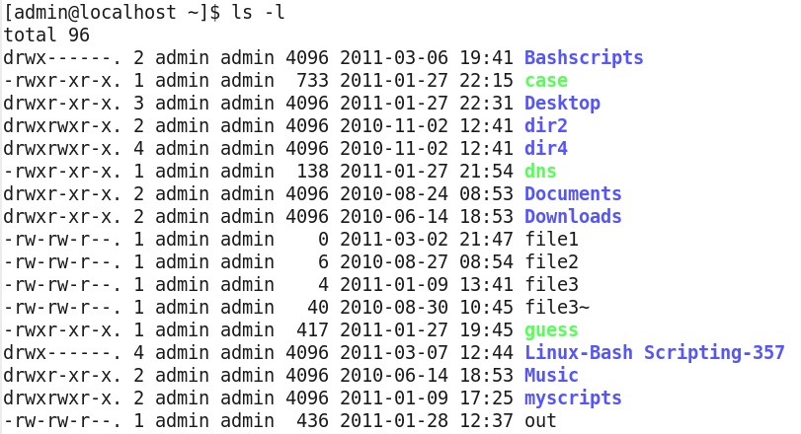
Linux File Types and Attributes
File Type Permissions Hard Links Size Time Stamp
Notes:
“Screen Capture of File Types is released under the GNU General Public License (GPL). See the terms at http://www.gnu.org/licenses/license-list.html”

Slide 15
Linux File Types and ls –l command
– (dash) in the first column represents a regular file
Letter d in the first column represents a directory
Letter l (el) in the first column represents a link or shortcut
ls –l
- rw-r --r -- Regular file
d rwxr-xr-x Directory
l rw-r --r -- link file
b rw-rw---- block in /dev directory
c rw-rw---- character in /dev directory

Slide 16
File/Directory commands
Some commands to manage file are:
touch
mv
cp
rm
grep
cat
cut
ln

Slide 17
Directory commands
Commands to manage directories are:
tree
ls
cd
pwd
mkdir

Slide 18
File Operations
Create
Delete
Open()
Close()
Read()
Write()
Append
Seek
Get attributes
Set Attributes
Rename
Notes:
Users communicates with File Manager via specific commands that may be either embedded in user’s program or submitted interactively by user.
Embedded commands:
OPEN and CLOSE pertain to availability of file for program invoking it.
READ and WRITE are I/O commands.
MODIFY – specialized WRITE command for existing data files that allows for appending/rewriting records
CREATE and DELETE -- deal with system’s knowledge of file.
SAVE -- first time used, a file is actually created.
OPEN NEW -- within a program indicates file must be created.
OPEN…FOR OUTPUT -- creates file by making entry for it in directory and finding space for it in secondary storage.
RENAME -- allows users to change name of existing file.
COPY – allows user to make duplicate copies of existing files.
In Linux when the kernel loads an inode into memory from disk, it stores a pointer to these file operations in a file_operations structure whose address is contained in the default_file_ops field of the inode_operations structure of the inode object.

Slide 19
File/Dir Protection
Types of access
Read
Write
Execute
Append
Delete
List
ACL Access Control List

Slide 20
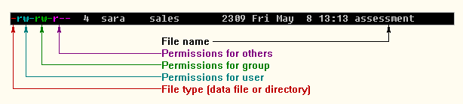
Files’ Permissions ls –l command
Notes:
“Permission is granted to copy, distribute and/or modify this document under the terms of the GNU Free Documentation License.”

Slide 21
Changing Files’ Permissions
Chmod syntax:
chmod [ugo] [+-=] [rwx] file-name
e.g.
chmod u+rw, g+r--, o+r-- file1 or
chmod 644 file1
In this example the user or owner can read and write file1. The group and others can only read file1

Slide 22
File SYSTEMS

Slide 23
File Management Functions
Identifies and locates files
Use a directory to describe the location of all files plus their attributes
On a shared system describe user access control
Maps files to storage devices. It allocates and deallocates blocks to files
Manage free storage for available blocks
Notes:
The most visible part of an OS is the file system .
Users and applications interact with the file system by means of commands for creating and deleting files and for performing operations on files. Before performing any operation, the file system must identify and locate the selected file. This requires the use of some sort of directory that serves to describe the location of all files and their attributes.In addition most shared systems enforced user access control: Only authorized users are allowed to access particular files.
Whereas users and applications are concerned with records, I/O is done on a block basis. Thus the records of a file must be blocked for output and unblocked after input. To support block I/O of files, the secondary storage must be managed. This involves allocating files to free blocks on secondary storage and managing free storage so as to know what blocks are available for new files.
Reference: Silberstchatz Galvin Gagne, Operating Systems concepts

Slide 24
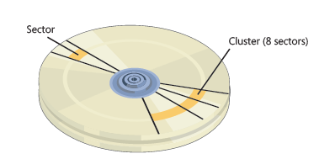
Disk Structure
Disk can be subdivided into partitions
Disks or partitions can be RAID protected against failure
Disk or partition can be used raw – without a file system, or formatted with a file system
Entity containing file system known as a volume
Each volume containing file system also tracks that file system’s info in device directory or volume table of contents
The technique used to access disk data is direct or random technique

Slide 25
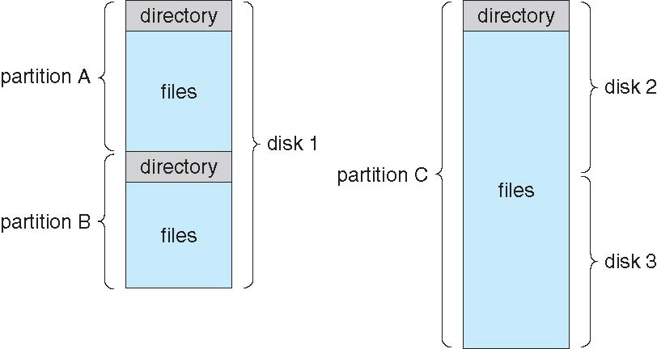
A Typical File-system Organization

Slide 26
File-System Structure
File system is the data structure (program ) that allows to create and manage a hierarchical file/directory structure.
File systems contains blocks, superblock (information about file system) and metadata (information about files).
File system resides on secondary storage (disks)
Provided user interface to storage, mapping logical to physical
Provides efficient and convenient access to disk by allowing data to be stored, located retrieved easily
File System
File Name
Inode
Data

Slide 27
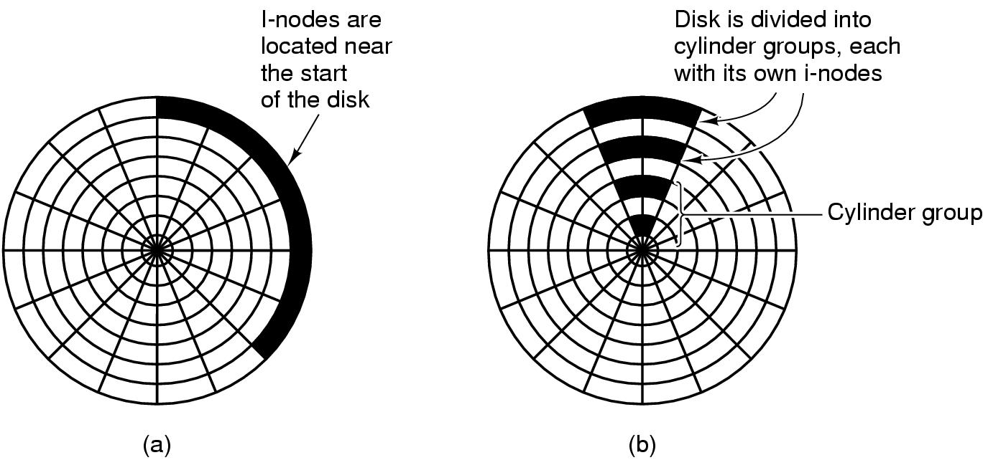
File systems Performance
Notes:
“This is a file from the Wikimedia Commons. Information from its description page there is shown below. Commons is a freely licensed media file repository”
“This work is free software; you can redistribute it and/or modify it under the terms of the GNU General Public License as published by the Free Software Foundation. This work is distributed in the hope that it will be useful, but without any warranty for more details. http://www.gnu.org/licenses/gpl.html”
One performance problem in systems that use I-nodes is that reading even a short file requires two disk accesses.
One for I-node and one for the block. The usual inode placement is shown in the figure (a) . Here all the I-nodes are near the beginning of the disk, so the average distance between an inode and its blocks will be about half the number of cylinders, requiring long seeks.
Figure (b) one easy performance improvement is to divide the disk into cylinder groups, each with its own I-nodes, blocks, and free list. When creating a new file, any I-node can be chosen, but an attempt is made to find a block in the same cylinder group as the I-node. If none is available, then a block in a nearby cylinder group is used.

Slide 28
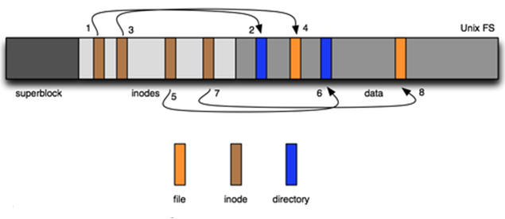
Disk layout in Unix
Notes:
“Google free image source http://work.tinou.com/data-structures/ “
Unix can handle multiple disk partitions each with a different file system on it.
Classical Unix, disk partition contains :
Boot block : Address 0 reserved for booting.
Superblock: Contains critical information about the layout of the file system, including the number of I-nodes, number of disk blocks, and the start of the list of free disk blocks( Typically a few hundred entries). Destruction of the superblock will render the file system unreadable.
i-node – index nodes , Each I-node is 64 bytes long and describes exactly one file. It contains information to locate all the disk blocks that hold the file’s data.
Data Blocks: All the files and directories are stored here. If a file or directory consists of more than one block, the blocks need not be contiguous on the disk.
As files grow, noncontiguous blocks linked to chain.Whenever possible files are stored in contiguous empty blocks.

Slide 29
The Superblock
The superblock contains information about file system and is located at the beginning of the disk slice, and is replicated in each cylinder group.
Because the superblock contains critical data, multiple superblocks are made when the file system is created.
The superblock stores the following:
Size and status of the file system
Label (file system name and volume name)
Size of the file system logical block
Date and time of the last update
Cylinder group size
Number of data blocks in a cylinder group
Summary data block
File system state
Path name of the last mount point

Slide 30
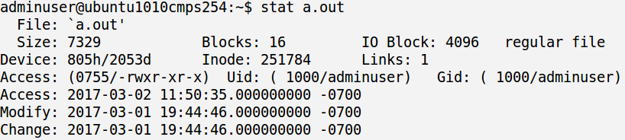
inode
Inode is a data structure in a Unix file systems that contains information about files and directories
inode stores the attributes and physical location (Disk blocks) of a file or directory
Linux file systems is based on inode entries.
The inode stores metadata about the file
https://www.youtube.com/watch?v=_6VJ8WfWI4k

Slide 31
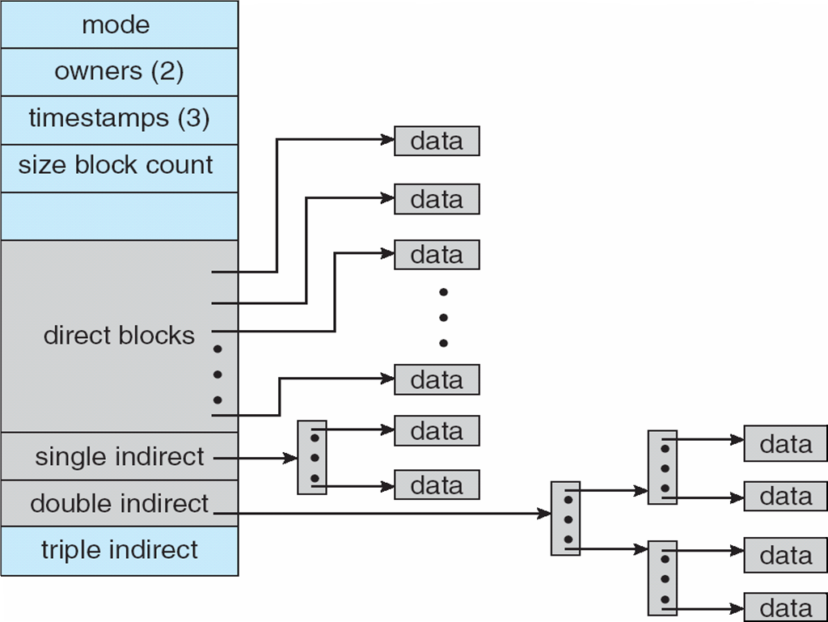
UNIX - inode

Slide 32
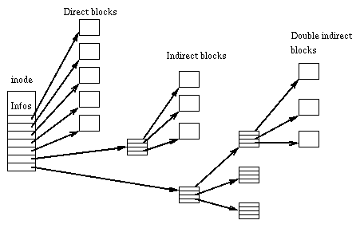
Unix i-node
Notes:
“This is a file from the Wikimedia Commons. Information from its description page there is shown below. Commons is a freely licensed media file repository”.
“This work is free software; you can redistribute it and/or modify it under the terms of the GNU General Public License as published by the Free Software Foundation. This work is distributed in the hope that it will be useful, but without any warranty.for more details. http://www.gnu.org/licenses/gpl.html
GPLGNU General Public License.” from http://en.wikipedia.org/wiki/Ext2
All information needed by the file system to handle a file is included in a data structure called I-node. Each file has its own inode, which the file system uses to identify the file.
The Unix inodes contains some attributes. The attributes contain: file size,creation, last access and last modification time, owner, group, protection information, and a count of the number of directory entries that point to the inode. When the count gets 0, the I-node is reclaimed and the disk blocks are put back in the free list. The first 10 disk addresses are stored in the inode itself, so for small files , all the necessary information is right in the inode, which is fetch from disk to main memory when the file is opened. For some larger files, one of the addresses in the inode is the address of a disk block called a single indirect block. This block contains additional disk addresses. If this is still not enough, another address in the I-node, called double indirect block, contains the address of a block that contains a list of a single indirect blocks. For extremely large files of more than 16,522 blocks, 13th entry points to a “triple indirect block.” is used.

Slide 33
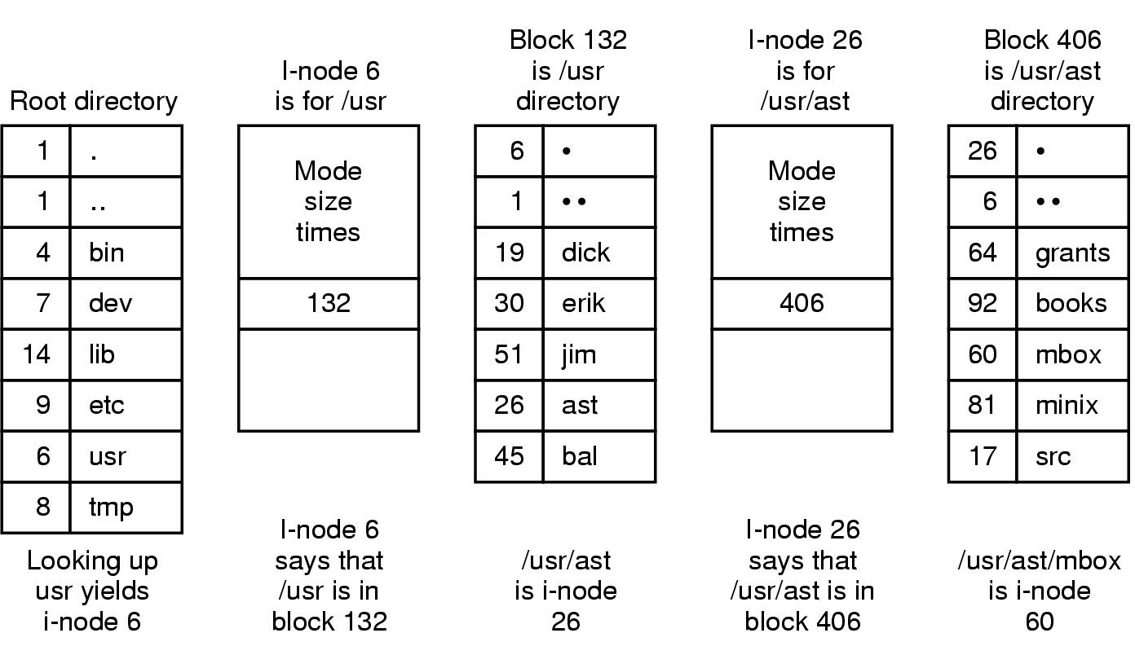
Example: searching for /usr/ast/mbox
Notes:
“This work is free software; you can redistribute it and/or modify it under the terms of the GNU General Public License as published by the Free Software Foundation. This work is distributed in the hope that it will be useful, but without any warranty.for more details. http://www.gnu.org/licenses/gpl.html”
When a file is opened, the file system must take the file name supplied and locate its disk blocks. First the file locates the root directory. In Unix its I-node is located at a fixed place on the disk. From this I-node , it locates the root directory which can be anywhere on the disk. Then it reads the root directory and looks up the first component of the path, usr, in the root directory to find the I-node number of the file /usr. (the remaining steps are explained on the slide)

Slide 34
Inode in action
https://www.youtube.com/watch?v=oHrlU3b1ZAw&x-yt-cl=85114404&x-yt-ts=1422579428

Slide 35
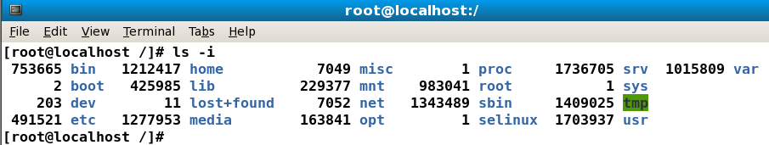
ls –i commands
This command displays the index to each file called inode
Notes:
“Screen Capture of ls –i command is released under the GNU General Public License (GPL). See the terms at http://www.gnu.org/licenses/license-list.html”

Slide 36
File Systems Types
Many file systems, sometimes many within an operating system each with its own format
Windows supports: FAT, FAT32, exFAT, ReFS, NTFS
CD-ROM is ISO 9660, CD, DVD Blu-ray uses UDF which supports larger files , larger disk and more info about files and directories
Linux default file system is extended file system ext2, ext3 and ext4 Linux supports more than 40 file systems including FAT and distributed file systems
Unix file systems has UFS, FFS
Virtual FS - VFAT
New FS– ZFS, GoogleFS, Oracle ASM, FUSE, Apache Hadoop HDFS

Slide 37
File Systems Features and Differences
What differentiates file systems?
File system structure – File allocation (extends) and directory structure (Link list or B+ tree)
Max Volume size
Max File Size
Max number of files
Max File Name
Max File path
https://en.wikipedia.org/wiki/Comparison_of_file_systems
https://msdn.microsoft.com/en-ca/library/windows/desktop/ee681827%28v=vs.85%29.aspx

Slide 38
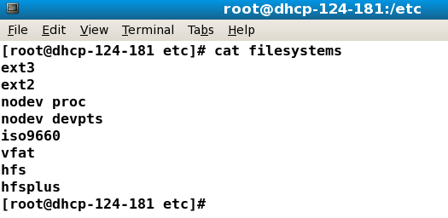
Linux File Systems
To verify all the file systems supported by the current kernel you can edit the file filesystems under /proc directory
# cat /proc/filesystems
Notes:
“Screen Capture of Linux File Systems is released under the GNU General Public License (GPL). See the terms at http://www.gnu.org/licenses/license-list.html”

Slide 39
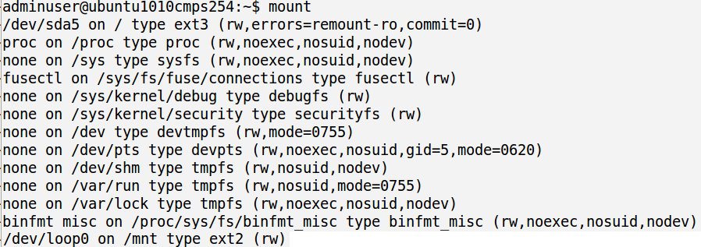
Linux File Systems Types
mount command displays all devices mounted and the respective file systems type and permissions

Slide 40
The Linux Proc File System
The proc file system does not store data, rather, its contents are computed on demand according to user file I/O requests
proc must implement a directory structure, and the file contents within; it must then define a unique and persistent inode number for each directory and files it contains
It uses this inode number to identify just what operation is required when a user tries to read from a particular file inode or perform a lookup in a particular directory inode
When data is read from one of these files, proc collects the appropriate information, formats it into text form and places it into the requesting process’s read buffer

Slide 41
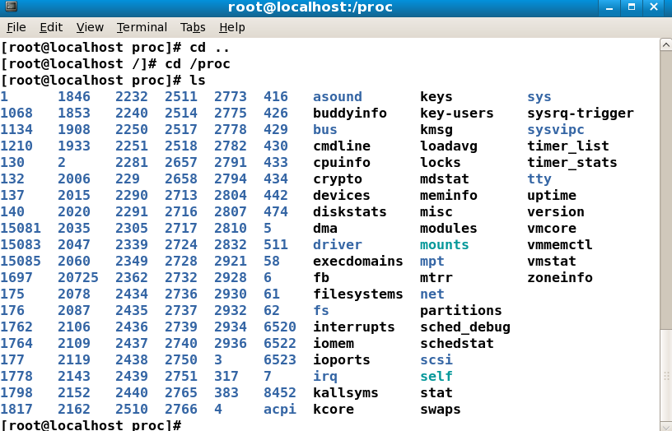
Proc file system
Pseudo-filesystem is used as an interface to kernel data
structure
Notes:
“Screen Capture of PROC file system is released under the GNU General Public License (GPL). See the terms at http://www.gnu.org/licenses/license-list.html”

Slide 42
Linux File System
Linux implements Ext2 File System:
It supports standard Unix file types: regular files, directories, device special files and symbolic links.
Allows the administrator to choose the logical block size when creating the file system
Checks on the file systems at boot time by e2fsck
Notes:
Ext2fs allows the administrator to choose the logical block size when creating
the file system. Block sizes can typically be 1024, 2048 and 4096 bytes. Using big block sizes can speed up I/O since fewer I/O requests, and thus fewer disk head seeks, need to be done to access a file. On the other hand, big blocks waste more disk space: on the average, the last block allocated to a file is only half full, so as blocks get bigger, more space is wasted in the last block of each file. In addition, most of the advantages of larger block sizes are obtained by Ext2 file system's preallocation techniques
Ext2fs provides two ways to force checks at regular intervals. A mount counter is maintained in the superblock. Each time the file system is mounted in read/write mode, this counter is incremented. When it reaches a maximal value (also recorded in the superblock), the file system checker forces the check even if the file system is ``Clean''. A last check time and a maximal check interval are also maintained in the superblock. These two fields allow the administrator to request periodical checks. When the maximal check interval has been reached, the checker ignores the file system state and forces a file system check.
Ext2 file system is not able to effectively address files larger than 2 GB (without mods to the kernel) and the file system is not journaled. This lack of journaling means that a system failure could result in several hours of downtime during a file system check after reboot and a subsequent failure during this rebuild could seriously damage the file system. (journaling now is being considered)

Slide 43
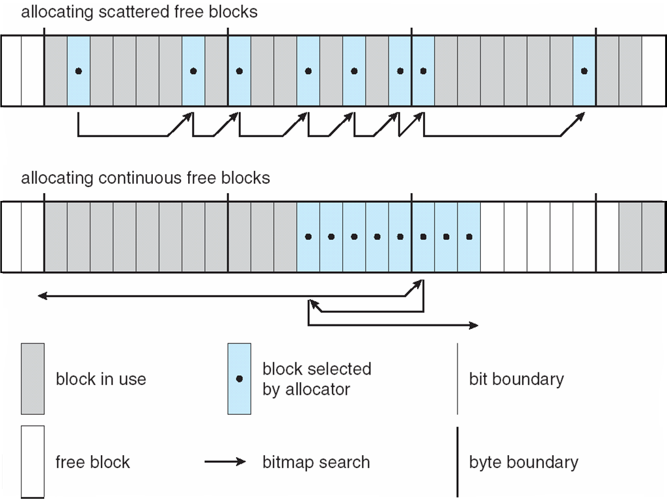
Ext2fs Block-Allocation Policies

Slide 44
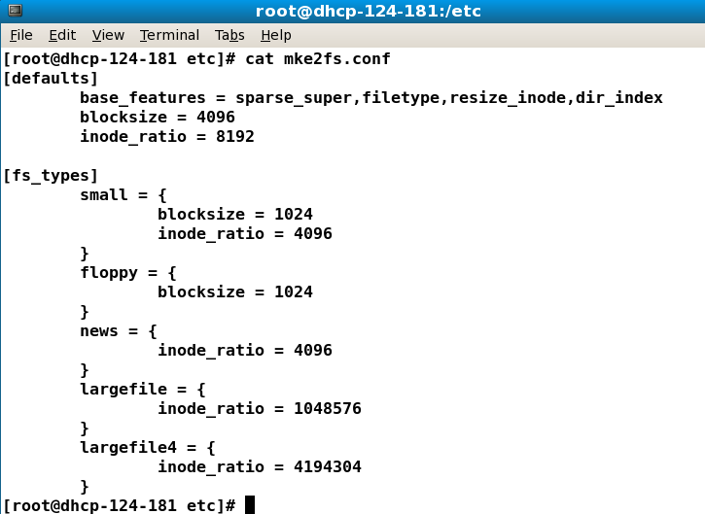
mke2fs
Notes:
“Screen Capture of mke2fs command is released under the GNU General Public License (GPL). See the terms at http://www.gnu.org/licenses/license-list.html”

Slide 45
Ext3 File System
Is a journaling file system
Has multiple journaling modes:
Ordered
Journal
Writeback
If data=ordered, forces data blocks to be written to disk soon after the log file is written. If data=journal, all data and metadata are written to disk through the journal. This is slower but safest. If data=writeback, dirty data blocks are not flushed to the disk before the metadata are written to disk through the journal.
Easy transition mke2fs
Notes:
The ext3 file system is a journaling extension to the standard ext2 file system on Linux. Journaling results in massively reduced time spent recovering a file system after a crash, and is therefore in high demand in environments where high availability is important, not only to improve recovery times on single machines but also to allow a crashed machine's file system to be recovered on another machine when we have a cluster of nodes with a shared disk.
The ext3 journal is usually stored in a hidden file name .journal located in the root directory of the file system. The Ext3 file system uses a general kernel layer named Journaling Block Device or JBD.
The tune2fs program can add a journal to an existing ext2 file system. If the file system is already mounted while it is being transitioned, the journal will be visible as the file.journal in the root directory of the file system. If the file system is not mounted, the journal will be hidden and will not appear in the file system.
It can journal all file data and metadata (data=journal), or it can journal metadata but not file data (data=ordered or data=writeback). When not journaling file data, you can choose to write file system data before metadata (data=ordered; causes all metadata to point to valid data), or not to handle file data specially at all (data=writeback; file system will be consistent, but old data may appear in files after an unclean system shutdown). This gives the administrator the power to make the trade off between speed and file data consistency, and to tune speed for specialized usage patterns.

Slide 46
Ext4
EXT4 implements extents instead of indirect block mechanism used in ext2 and ext3.
Extents specify an initial block address and the number of blocks that make up the extent.
A file that is fragmented will have multiple extents, but EXT4 tries to keep files contiguous.
For performance reasons, ext4 by default only writes filesystem metadata through the journal. This means there is not guaranteed that file data blocks are in any consistent state after a crash

Slide 47
Linux File systems –ext4
http://www.kernel.org/doc/Documentation/filesystems/
http://www.kernel.org/doc/Documentation/filesystems/ext4.txt

Slide 48
Reiser FS
Raiser3FS was created in 2001 and it was the first journaling FS included in Linux kernel
Reiser4 was developed in 2004. Now it has features that support SSD (Solid State Disk) such as discard. This feature is about discarding blocks by informing the SSD about blocks that are no longer in use by the file-system
File Size 1 EB (8TB on 32-bit system) 8TB
Max File Name Length 4032 bytes 3976 bytes
Max Volume Size 16 TB

Slide 49
Advanced File systems features
Hard and Soft links
Journal File (log file for recovering)
Sparse file. Sparse file is a file that uses file system space efficiently when the file is mostly empty. This can be done by writing metadata representing the empty blocks to disk instead of the actual "empty" space which makes up the block, using less disk space.

Slide 50
Hard and Soft links
Hard link is another name for existing file. Link and original are the same. The existing file and hard links to the file have the same i-node
Symbolic link is a special type of file with its own i-node. The original file and soft link has different inode
To differentiate hard link from soft link access and read the information using the following linux command: info ln

Slide 51
Journal File
Journal file is a log file that stores and keeps track of file system changes and the reasons for the changes. e.g. of file system changes are:
File/Dir attributes
File/Dir Content
File/Dir name
File/Dir inode
Security descriptor
Introduced in ext3, the ext4 filesystem employs a journal to protect the filesystem against corruption in the case of a system crash.
Ext2 does not have journal file by default, but ext2 can be tune using tune2fs –j and add journal file to it.
In ext4 you can verify journal file features as follows:
sudo dumpe2fs /dev/sda2 | grep -i journal

Slide 52

File System Mounting
A file system must be mounted before it can be accessed
A unmounted file system (i.e., Fig. 11-11(b)) is mounted at a mount point
A mount point is an empty directory that can be used to attach a file system

Slide 53
Mount Point

Slide 54
Mount Commands
Mount Syntax is
#mount -t file-system device-name mount-point
e.g. Mount a CD-ROM
#mount -t iso9660 /dev/hdc /media/cdrom
#umount /media/cdrom
e.g. Mount a floppy disk
#mount /dev/fd0 /mnt
# umount /mnt
e.g. Mount a usb device
#mount -t vfat /dev/sdb1 /media/DISK_IMG
# umount /media/DISK_IMG

Slide 55
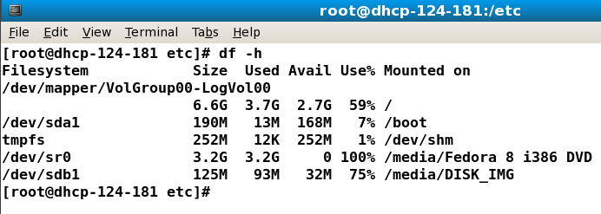
df command
df command displays current file systems disk space usage
Notes:
“Screen Capture of df command is released under the GNU General Public License (GPL). See the terms at http://www.gnu.org/licenses/license-list.html”

Slide 56
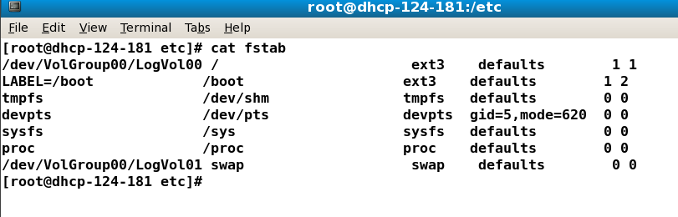
/etc/fstab file
This file contains details of permanent mounted file systems.
To mount a device temporally use the command mount and to mount the device permanently add the respective entries to the /etc/fstab file

Slide 57
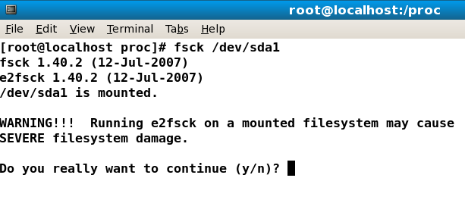
fsck command
fsck is used to check and optionally repair one or more Linux file systems.
filesys can be a device name (e.g. /dev/hdc1, /dev/sdb2), a mount point (e.g. /, /usr, /home), or an ext2 label
In order to run fsck the file system has to be unmounted
Notes:
“Screen Capture of fsck command is released under the GNU General Public License (GPL). See the terms at http://www.gnu.org/licenses/license-list.html”

Slide 58
fsck Utility
The fsck is a utility used to detect and correct file systems problems
Fsck checks different file system structures in each pass, as follows:
Blocks and size
Pathnames
Connectivity
Reference counts
Cylinder groups

Slide 59
File System calls
Open() system call
Takes a file name, searches the directory, checks file protection
Copies directory entry into open-file table
Returns an integer pointer to the entry in open-file table for subsequent use
Close() system call
Flushes cached file data back to the storage device
Deletes entry from open-file table
Frees system resources
Operation in a multiuser environment
Per-process and global open-file tables
System maintains reference counts for opened files

Slide 60
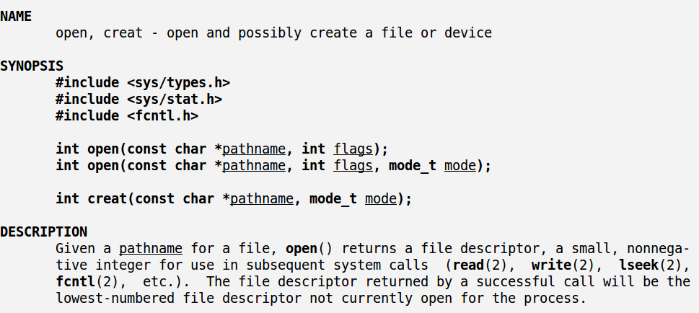
Open and Creat System Calls

Slide 61
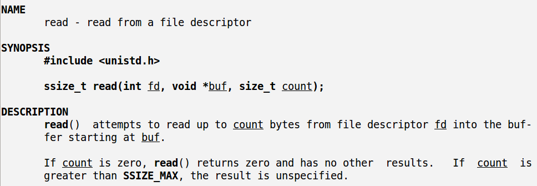
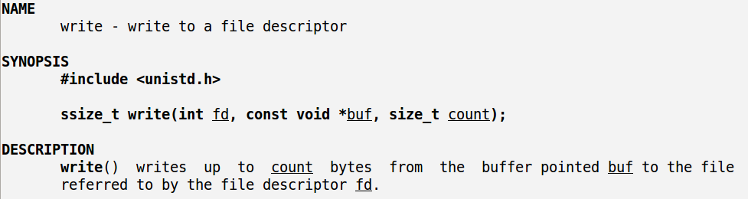
Read and Write System Calls

Slide 62
Open Files
Several pieces of data are needed to manage open files:
Open-file table: tracks open files
File pointer: pointer to last read/write location, per process that has the file open
File-open count: counter of number of times a file is open – to allow removal of data from open-file table when last processes closes it
Disk location of the file: cache of data access information
Access rights: per-process access mode information
In windows are called handles

Slide 63
Access Methods
Sequential Access
read next
write next
reset
no read after last write
(rewrite)
Direct Access – file is fixed length logical records
read n
write n
position to n
read next
write next
rewrite n
n = relative block number

Slide 64
Text Book Slides – Copy Right

Slide 65
End of Chapter 11

